Slide 1
Algorithm Final Project
Advanced high-resolution approaches:
Human health and biodiversity genomics
Supervised by: Dr/ Ibrahim El- Semman
Eng/ Nehad Abdelraheem

Slide 2
Contents of This Presentation
Here’s the Content:
Introduction of human health and biodiversity genomics.
Haplotype-resolved genome assembly.
HI-FI Algorithm.
HI-C Technology.
Tools: WhatsHap , HapCut , HapCol.
Graphs.
ERGA
References

Slide 3
Human health and biodiversity genomics.
Genomics now regularly plays a central and catalytic role in basic and translational research, and studies increasingly demonstrate the vital role that genomic information can play in clinical care.
The anticipated advances in technology development, biological insights, and clinical applications (among others) will lead to more widespread integration of genomics into virtually all areas of biomedical research.

Slide 4
Haplotype-resolved or phased genome assembly.
Diploid assembly (DipAsm) that uses long, accurate reads and long-range conformation data for single individuals to generate a chromosome-scale phased assembly within 1 day.
DipAsm will facilitate high-quality precision medicine and studies of individual haplotype variation and population diversity.

Slide 5
HI-FI Algorithm (Hifiasm)

Slide 6
HiFi sequencing method yields highly accurate long-read sequencing datasets with read lengths averaging 10–25 kb and accuracies greater than 99.5%.
These accurate long reads can be used to improve results for complex applications such as single nucleotide and structural variant detection, genome assembly, assembly of difficult polyploid or highly repetitive genomes.

Slide 7
HI–C Technology
Hi-C: A Method to Study the Three-dimensional Architecture of Genomes.
Hi-C (or standard Hi-C) is a high-throughput genomic and epigenomic technique first described in 2009 by Lieberman-Aiden.

Slide 8
Hi-C is considered as a derivative of a series of chromosome conformation capture technologies, including but not limited to 3C (chromosome conformation capture), 4C (chromosome conformation capture-on-chip/circular chromosome conformation capture), and 5C (chromosome conformation capture carbon copy).
Hi-C comprehensively detects genome-wide chromatin interactions in the cell nucleus by combining 3C and next-generation sequencing (NGS) approaches and has been considered as a qualitative leap in C-technology (chromosome conformation capture-based technologies) development and the beginning of 3D genomics.

Slide 9
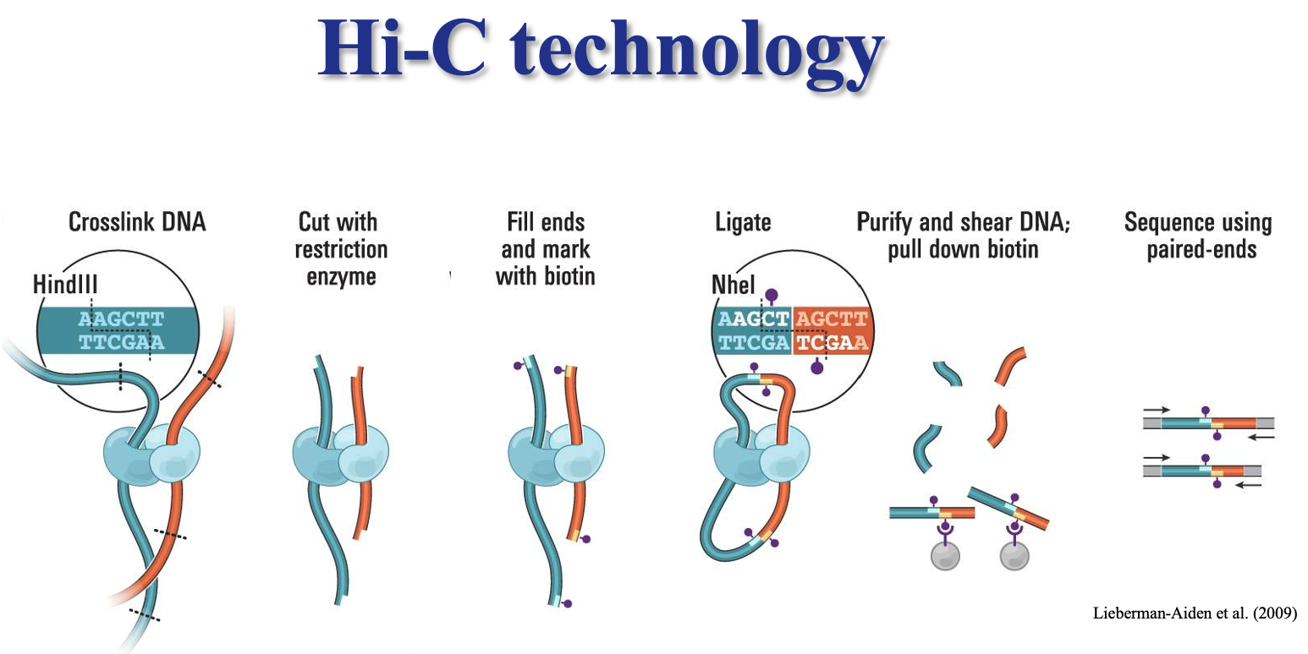

Slide 10

Tools
Many tools have been developed for haplotype assembly-the reconstruction of individual haplotypes using reads mapped to a reference genome sequence.

Slide 11




WhatsHap
HapCut
HapCol

Slide 12
WhatsHap
“
“
The command-line front-end of WhatsHap is written in Python 3 due to its simplicity and maintainability.
WhatsHap is easily installed from the Python Package Index (PyPI) or Conda's bioconda channel with a single pip3 install or conda install command.

Slide 13

WhatsHap is a command-line tool is written in Python 3 that expects– in the common case– a single Variant Call Format (VCF) file and one or more BAM files as input.
The command whatsHap phase–o phased.vcf input.vcf input.bam is typically sufficient.
WhatsHap phases all samples it finds in a multi-sample VCF, using BAM read groups and VCF sample names to associate each read to its originating sample.
WhatsHap comes with a collection of other functionalities to handle phasing data. These functionalities are available as sub-commands, allowing to conveniently combine them into larger analysis pipelines.

Slide 14
HapCut
“
“
HapCUT2 rapidly assembles haplotypes with best-in-class accuracy for all data types.
HapCUT2 scales well for high sequencing coverage and rapidly assembled haplotypes for two long-read WGS data sets on which other methods struggled.

Slide 15

(HapCUT) to handle multiple sequencing technologies. Using simulations and whole-genome sequencing (WGS) data from multiple different data types-dilution pool sequencing, linked-read sequencing, single molecule real-time (SMRT) sequencing, and proximity ligation (Hi-C) sequencing.

Slide 16
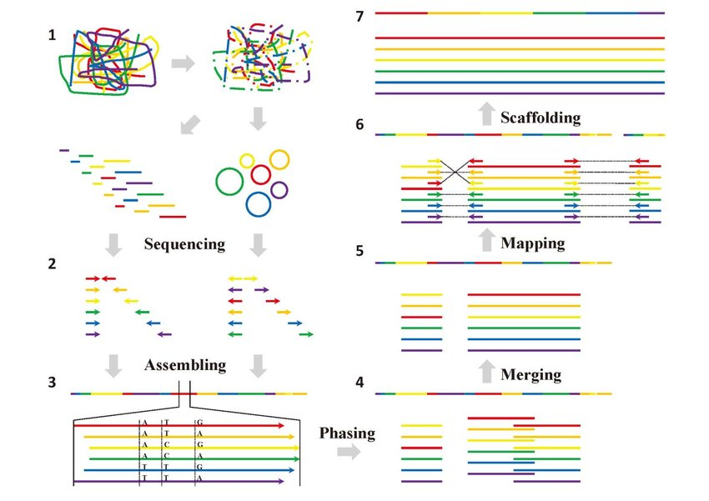
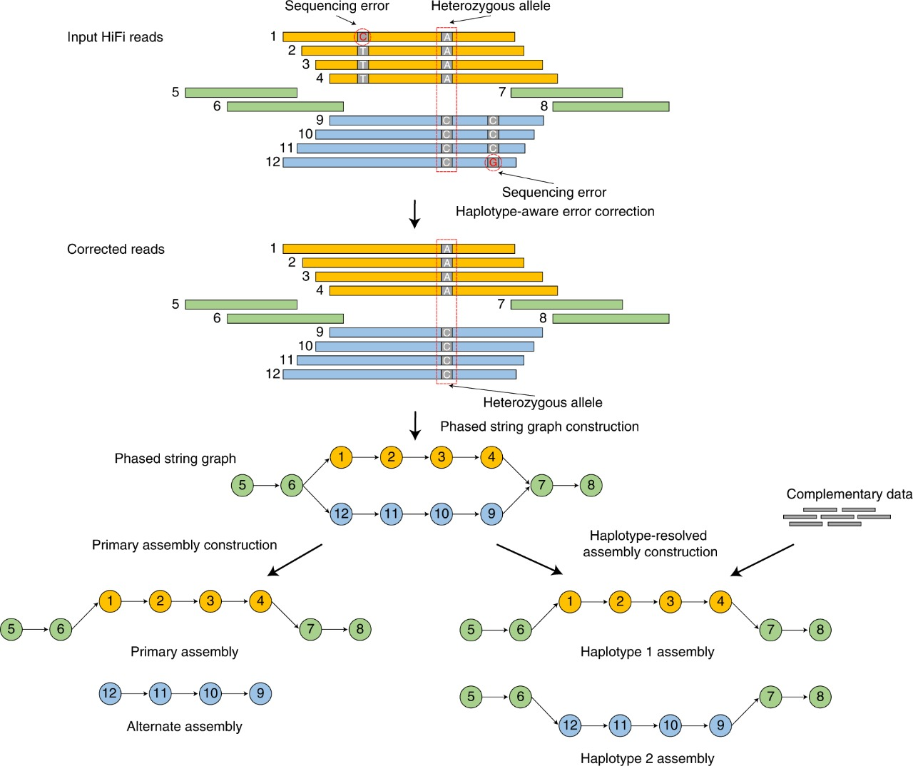
Graph

Slide 17
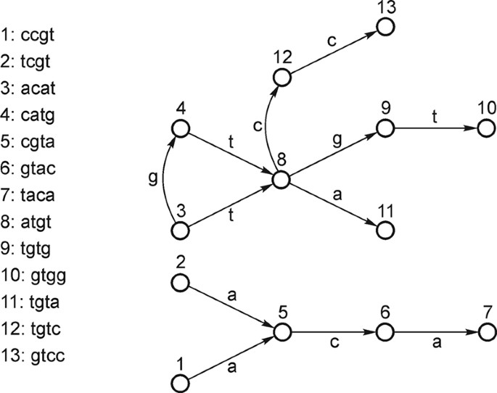
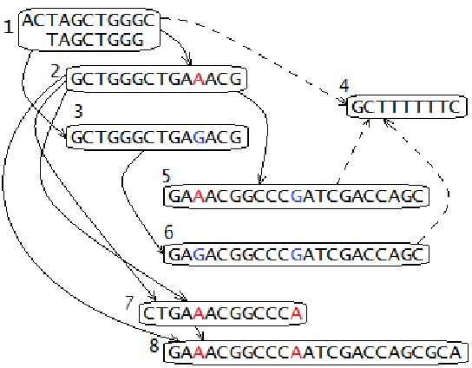
Overlap Graph

Slide 18
ERGA
The European Reference Genome Atlas (ERGA) initiative is a pan-European scientific response to current threats to biodiversity. Reference genomes provide the most complete insight into the genetic basis that forms each species and represent a powerful resource in understanding how biodiversity functions.
With approximately one fifth of the 200,000 European species at risk of extinction, we need to act fast and together to generate high-quality complete genome resources in large scale.

Slide 19
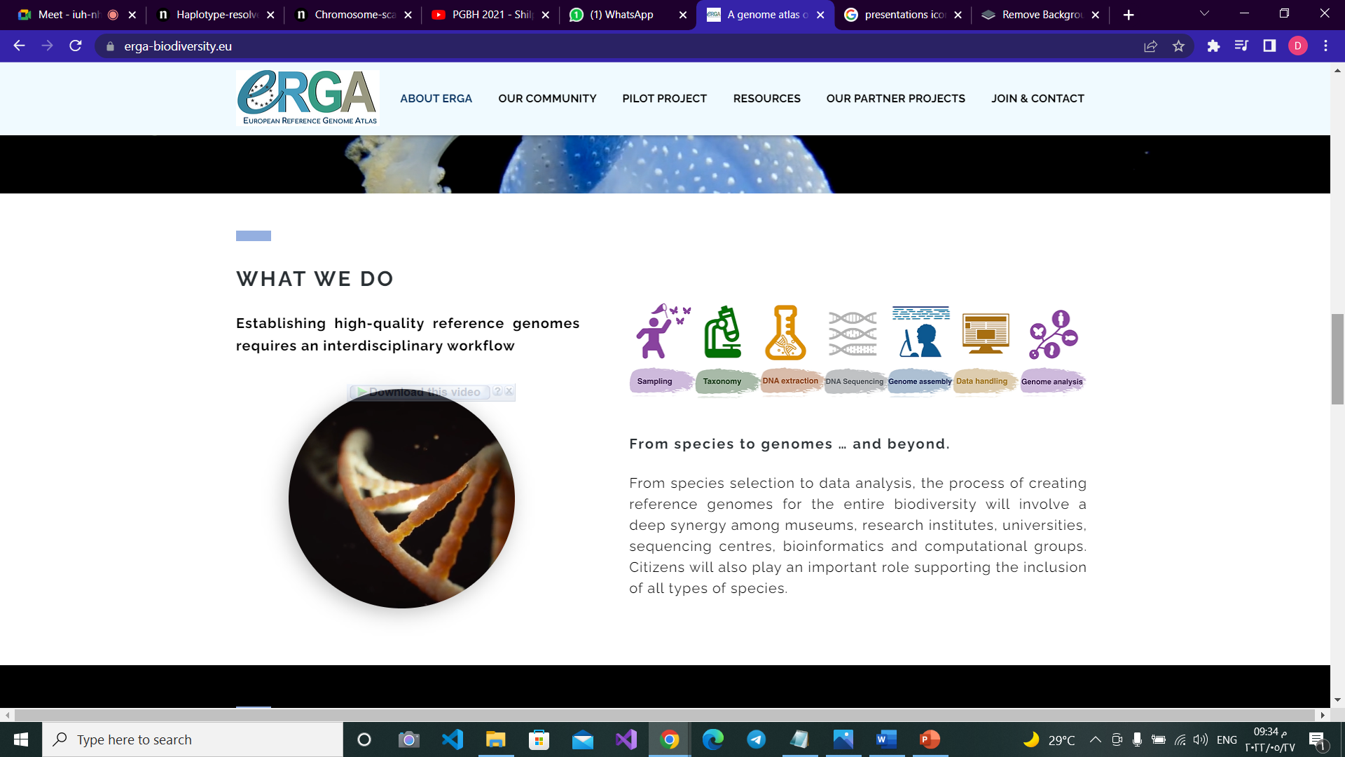
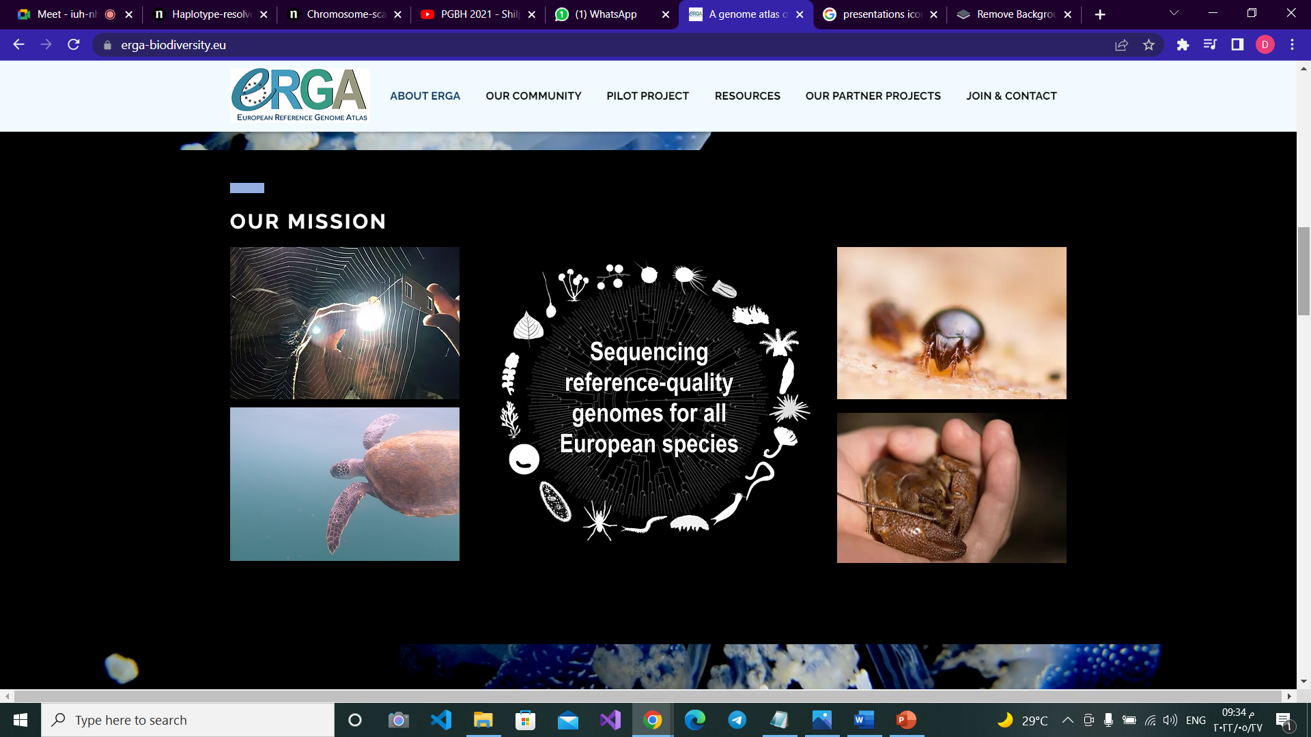
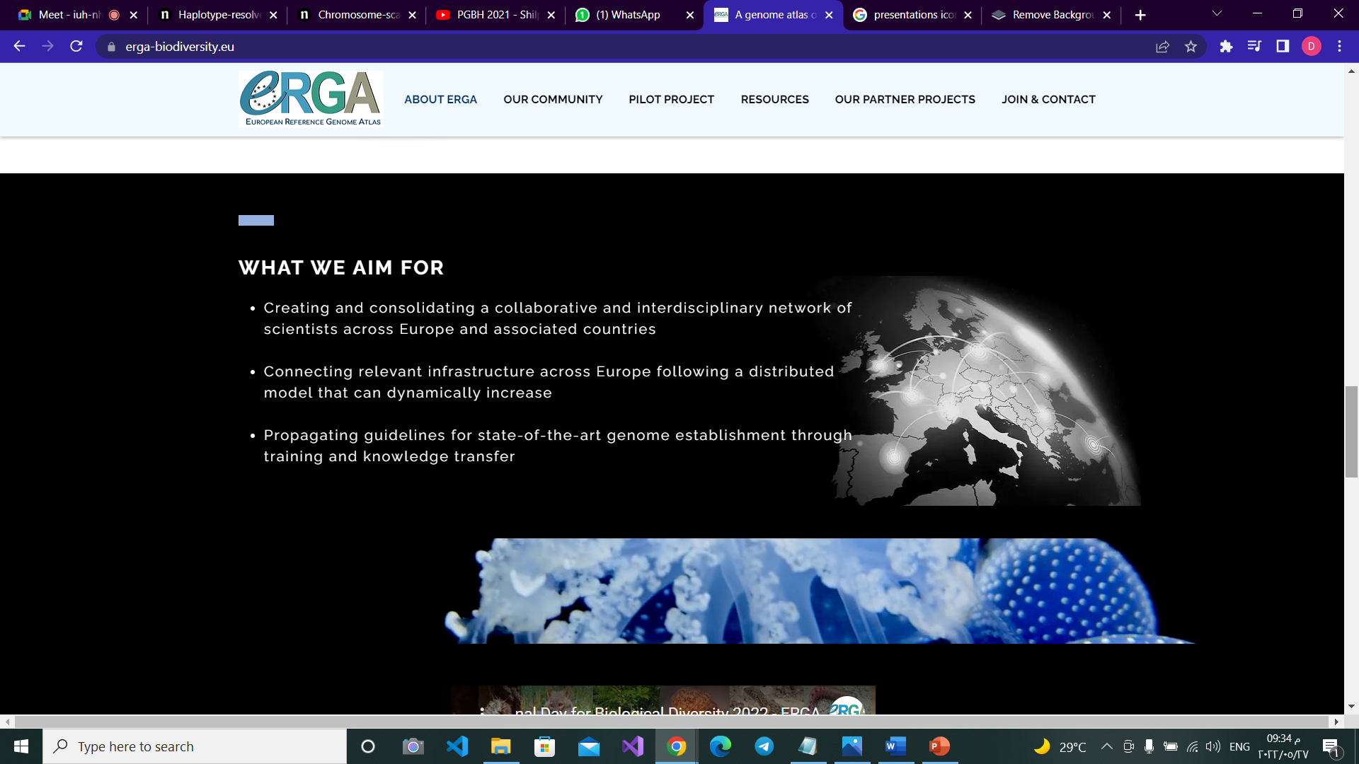

Slide 20

References
https://www.biorxiv.org/content/10.1101/085050v2.full
https://pubmed.ncbi.nlm.nih.gov/27940952/
https://www.erga-biodiversity.eu/
https://www.nature.com/articles/s41587-020-0711-0

Slide 21

Team Members:
Doaa Sayed Ibrahim Morsy (Group 2 section 1)
Rahma Yasser Mahmoud Abd- elsalam (Group 2 section 2)
Yasmeen Hossam El-din Mohamed Mahran (Group 4 section 4)
Ahmed Mohsen Mohamed Ahmed (Group 1 section 1)
Mohamed Mamdouh Allam Ahmed (Group 4 section 1)
Mahmoud Sayed Youssef Kotb (Group 4 section 1)
Mena Nashaat Fayez Khalil (Group 4 section 3)

